Slide 1
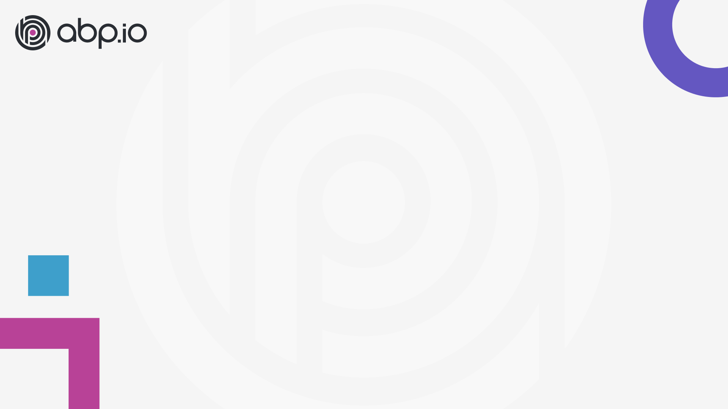
ABP Community Talks 2022.5
MAUI & ABP Framework

Slide 2
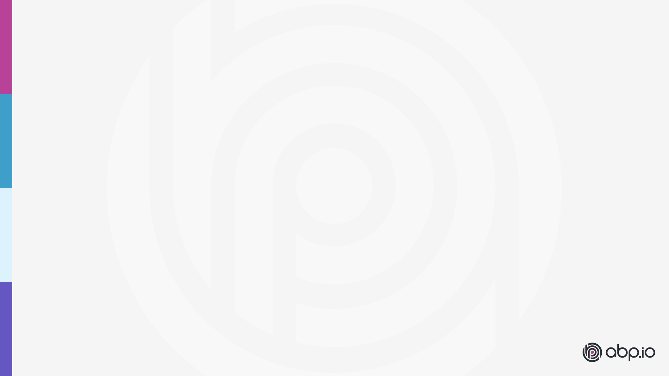
Agenda
ABP news / Halil İbrahim Kalkan
Presentation: What is MAUI? / Alper Ebiçoğlu
Demo: MAU (with Blazor) & ABP / Enis Necipoğlu
Discussions & Questions

Slide 3
ABP v5.3.0
what’s new with this version

Slide 4
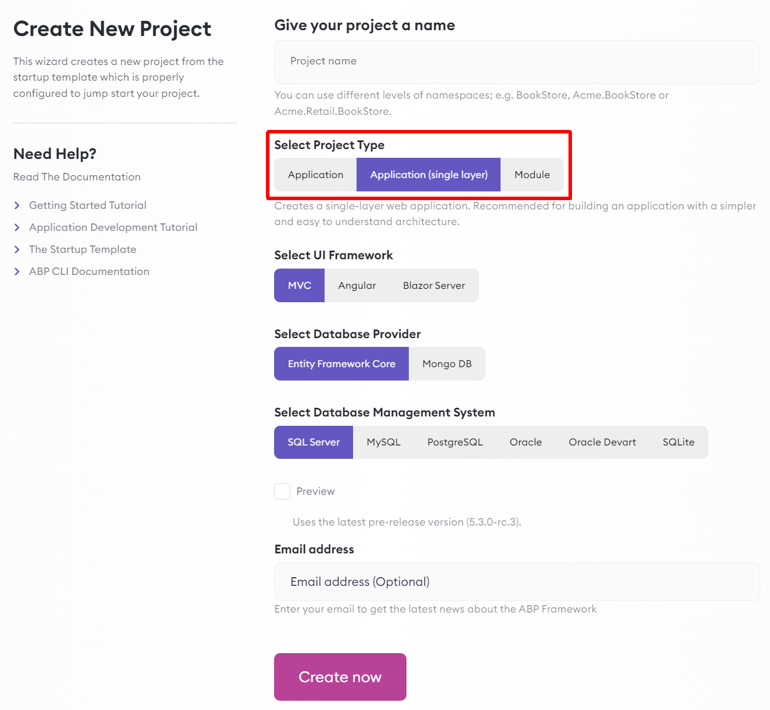
Single-Layer Solution Template
Download from:
https://abp.io/get-started
Use ABP CLI: abp new TodoApp -t app-nolayers
Quick Start: https://docs.abp.io/en/abp/5.3/Tutorials/Todo/Single-Layer/Index
Solution structure: https://docs.abp.io/en/abp/5.3/Startup-Templates/Application-Single-Layer

Slide 5
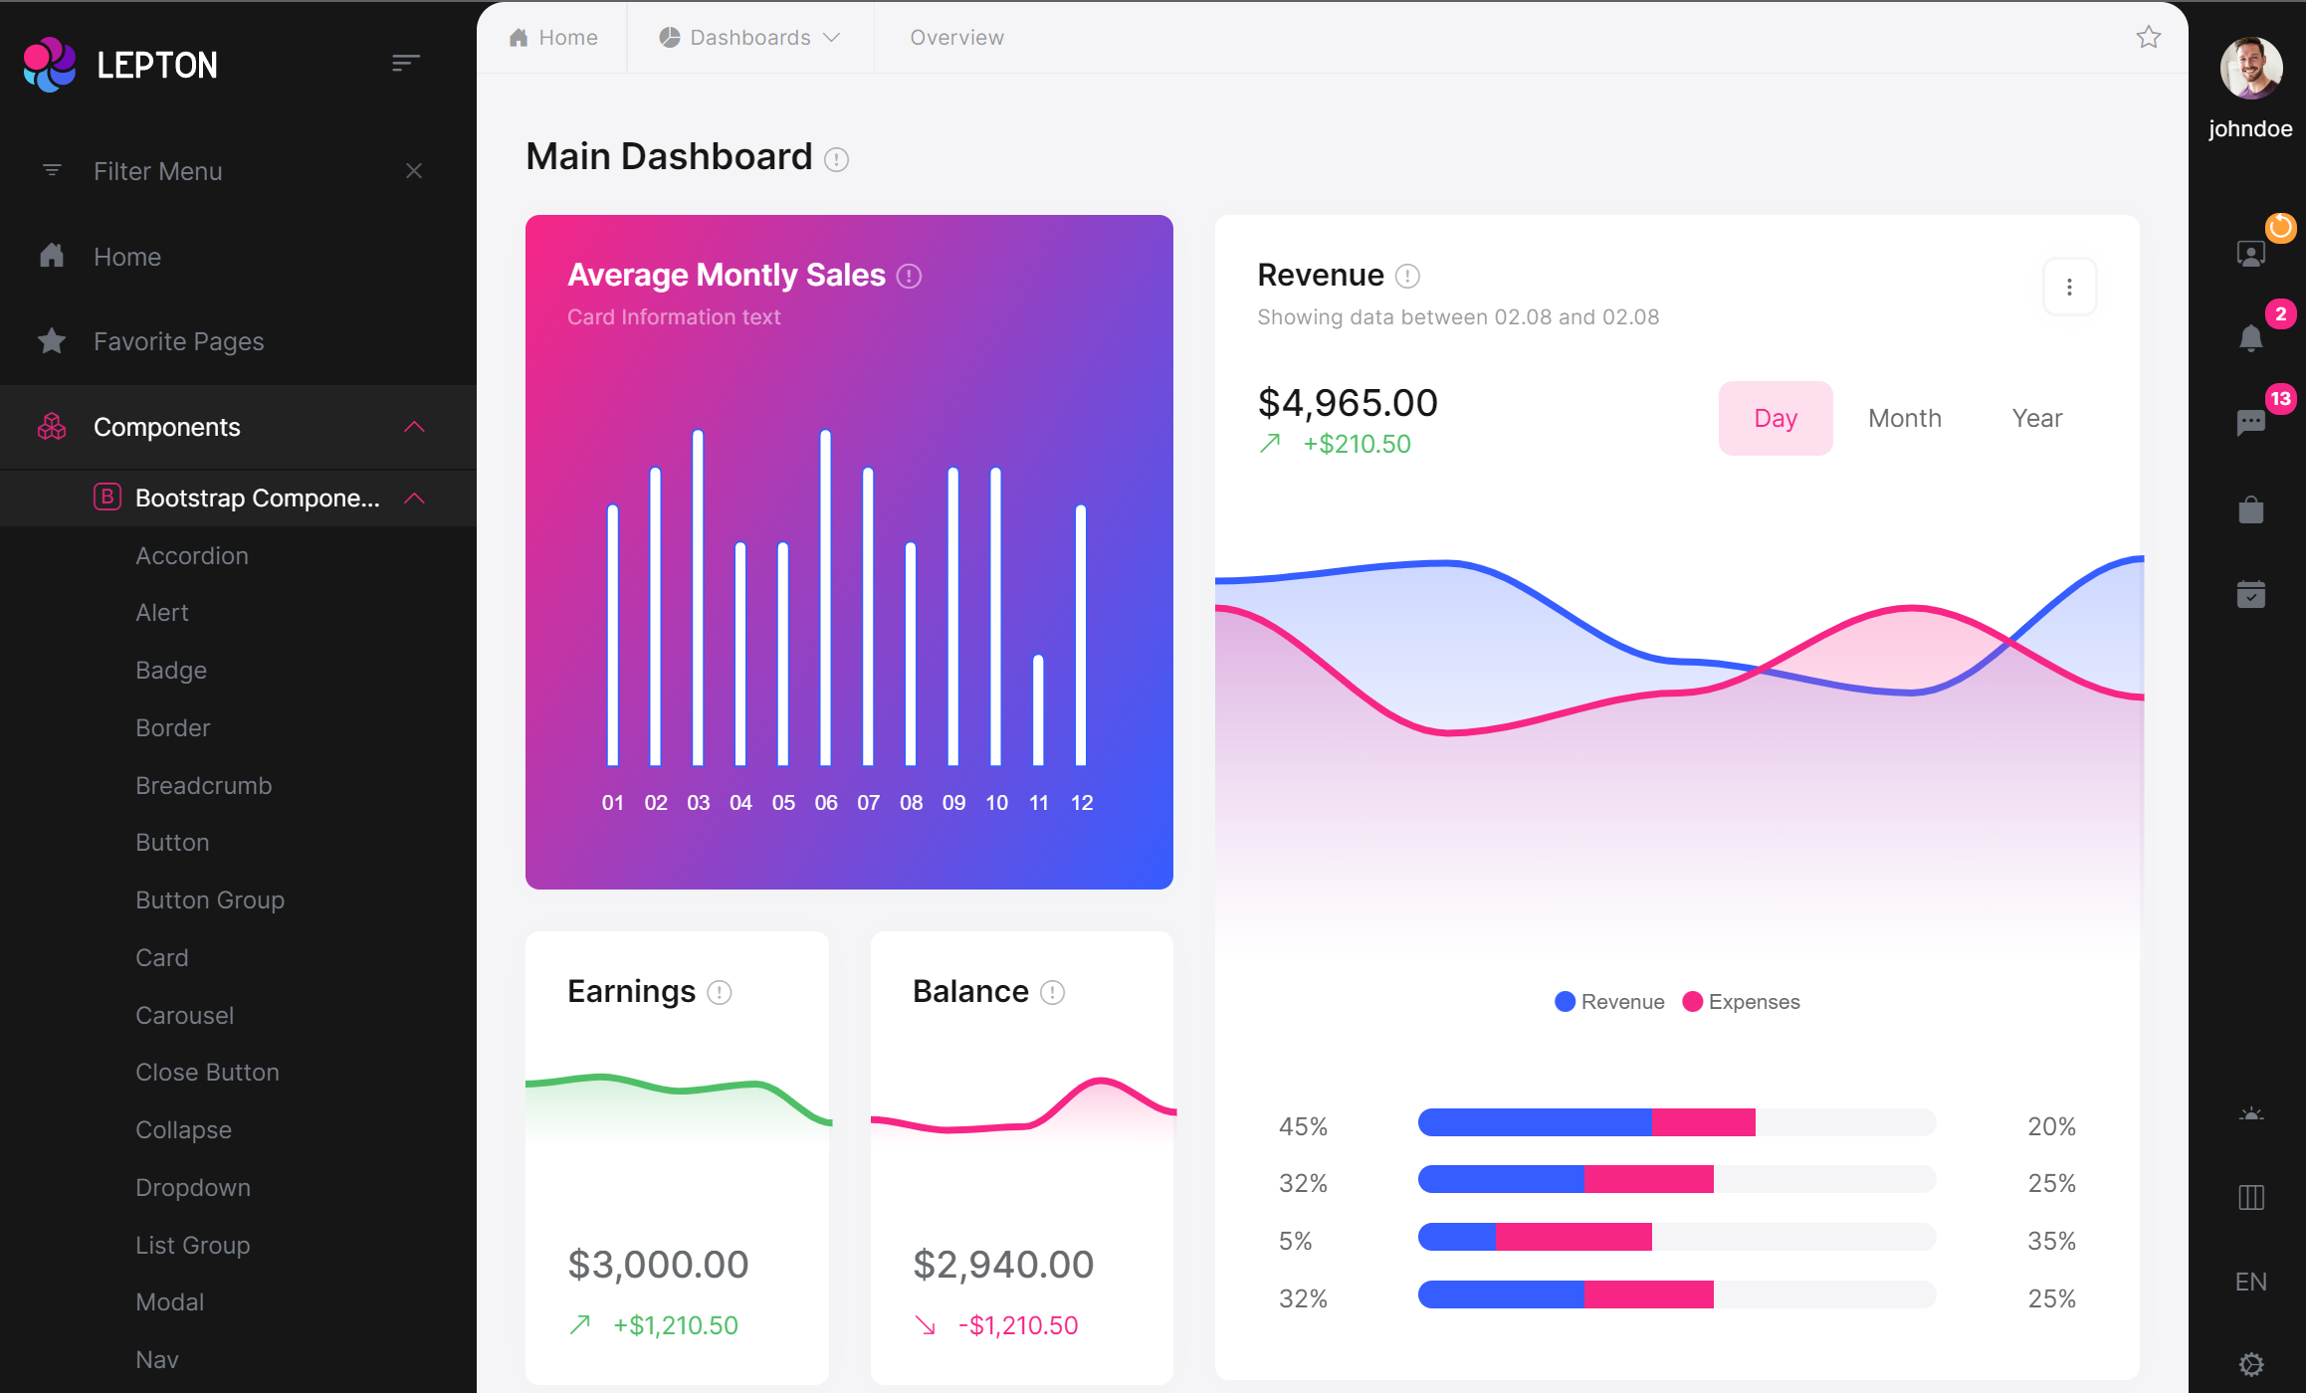
LeptonX theme v1.0 beta https://x.leptontheme.com

Slide 6
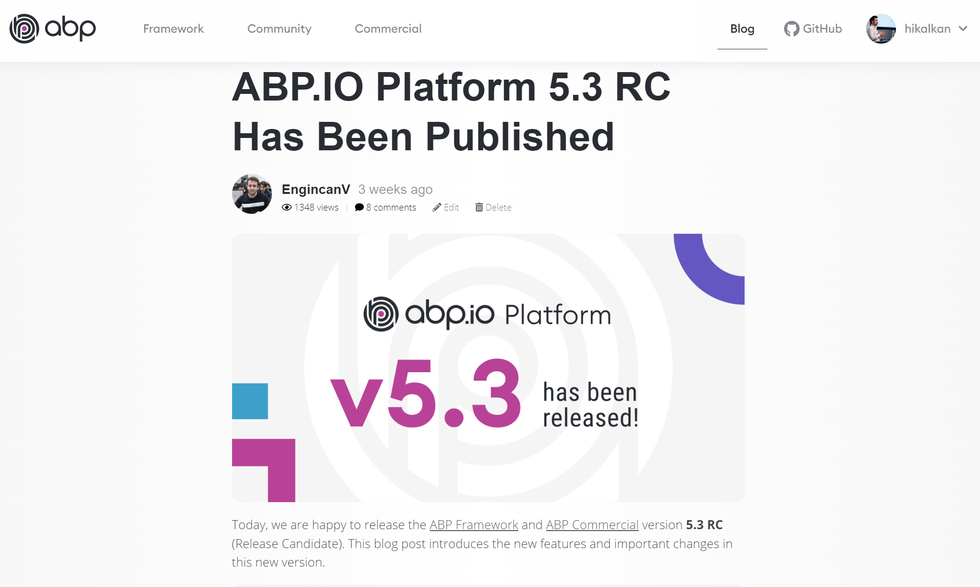
https://blog.abp.io

Slide 7
ABP Release Schedule
6.0 RC (2022-06-28)
OpenIddict, LeptonX (default), Simple MAUI startup template
6.0 Stable (2022-07-26)
7.0 RC (2022-11-15)
Based on .NET 7.0
7.0 Stable (2022-12-13)
7.1, 7.2… etc.

Slide 8
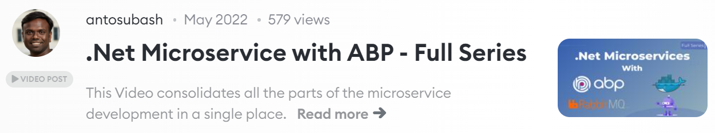
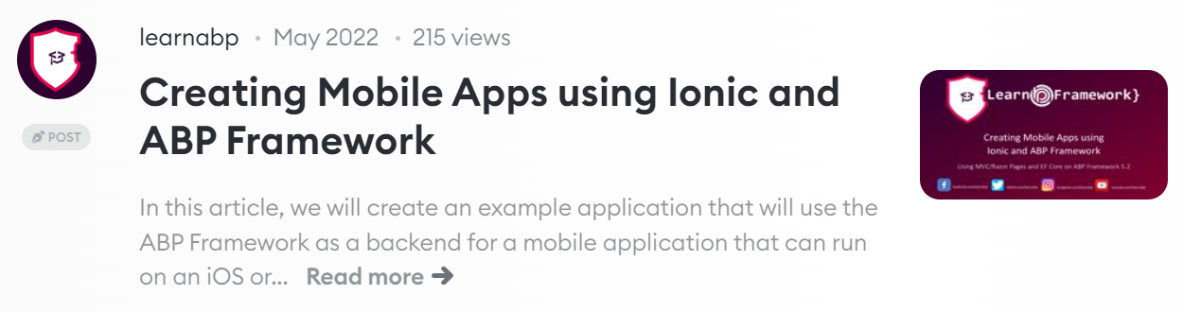
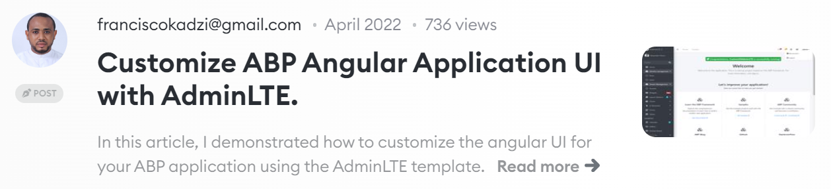
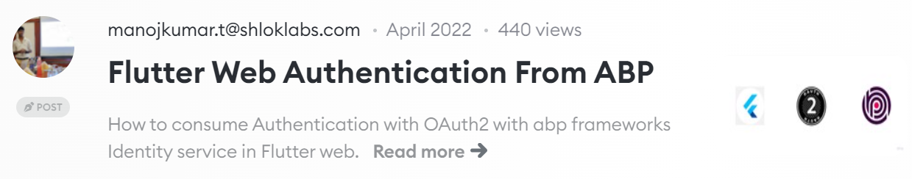
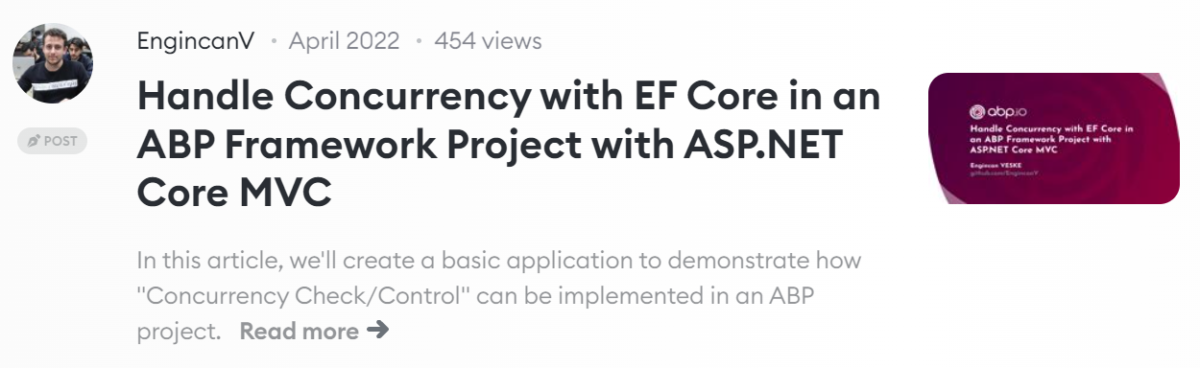
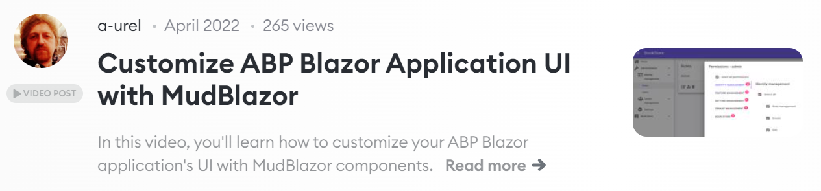
ABP Community posts https://community.abp.io
https://community.abp.io/posts/submit

Slide 9





The ABP Community
GitHub: Bug reports, feature requests & discussions http://github.com/abpframework
StackOverflow: Questions https://stackoverflow.com/questions/tagged/abp
Discord: Any kind of interaction https://discord.gg/abp
Twitter: Follow for the latest news from ABP http://twitter.com/abpframework
YouTube: Video tutorials and live events https://www.youtube.com/c/Volosoft

